Slide 1
Dynamic HTML: Object Model and Collections
Outline
1 Introduction
2 Object Referencing
3 Collections all and children
4 Dynamic Styles
5 Dynamic Positioning
6 Using the frames Collection
7 navigator Object
8 Summary of the DHTML Object Model

Slide 2
Objectives
In this lesson, you will learn:
To use the Dynamic HTML Object Model and scripting to create dynamic Web pages.
To understand the Dynamic HTML object hierarchy.
To use the all and children collections to enumerate all of the XHTML elements of a Web page.
To use dynamic styles and dynamic positioning.
To use the frames collection to access objects in a separate frame on your Web page.
To use the navigator object to determine which browser is being used to access your page.

Slide 3
1 Introduction
Dynamic HTML Object Model
Allows Web authors to control the presentation of their pages
Gives them access to all the elements on their pages
Web page
Elements, forms, frames, tables
Represented in an object hierarchy
Scripting
Retrieve and modify properties and attributes

Slide 4
2 Object Referencing
The simplest way to reference an element is by using the element’s id attribute.
The element is represented as an object
XHTML attributes become properties that can be manipulated by scripting

Slide 5
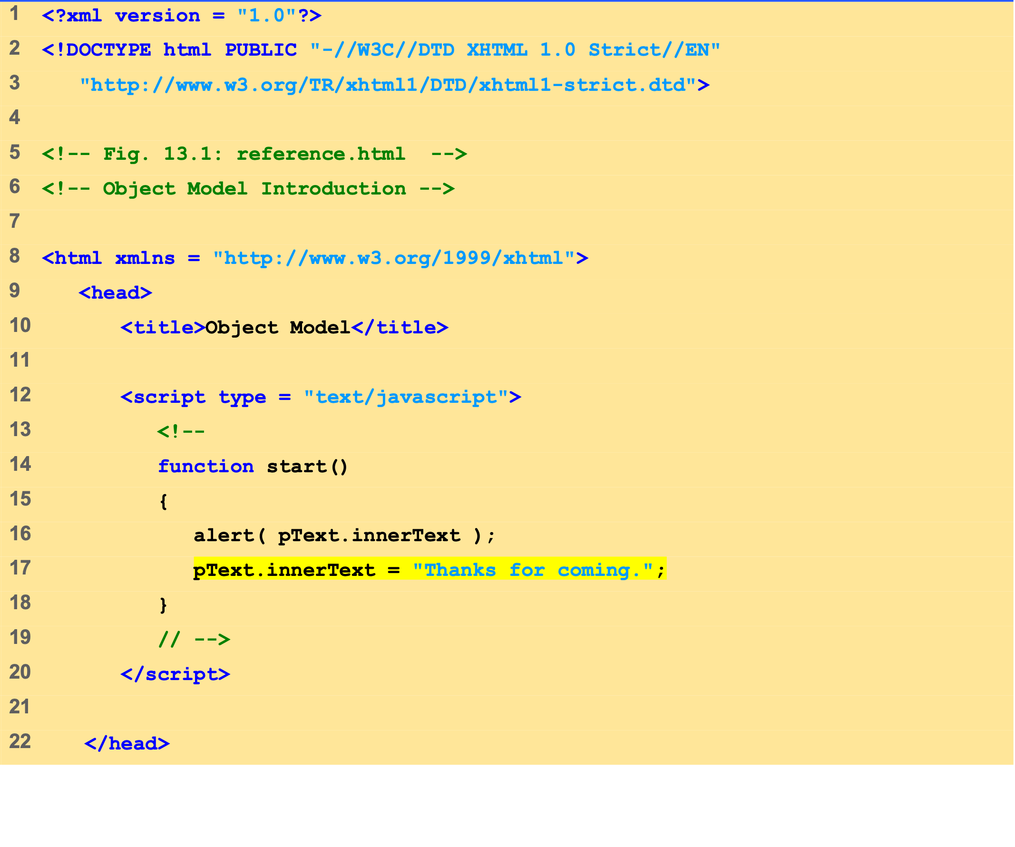
Outline
reference.html (1 of 2)

Slide 6
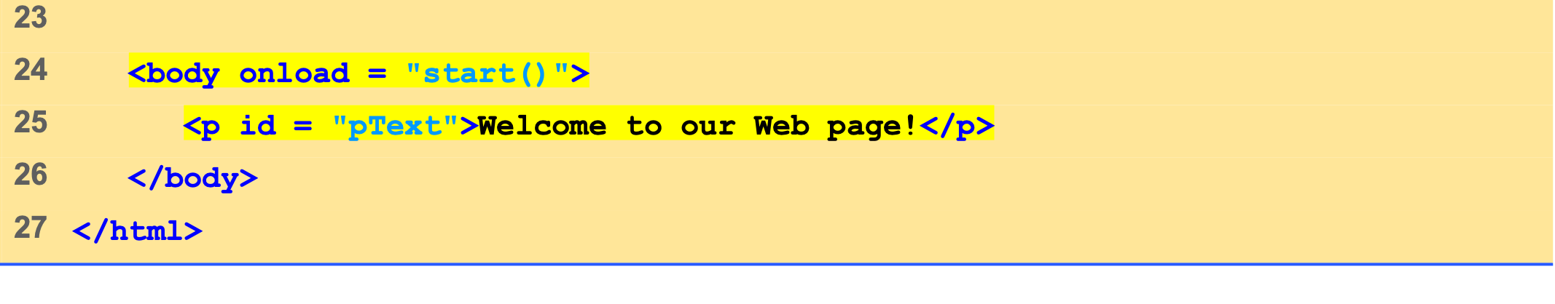
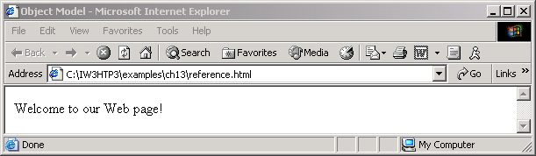

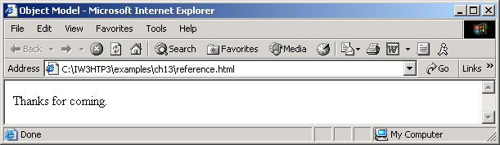
Outline
reference.html (2 of 2)

Slide 7
3 Collections all and children
Collections
Arrays of related objects on a page
all
all the XHTML elements in a document
children
Specific element contains that element’s child elements

Slide 8
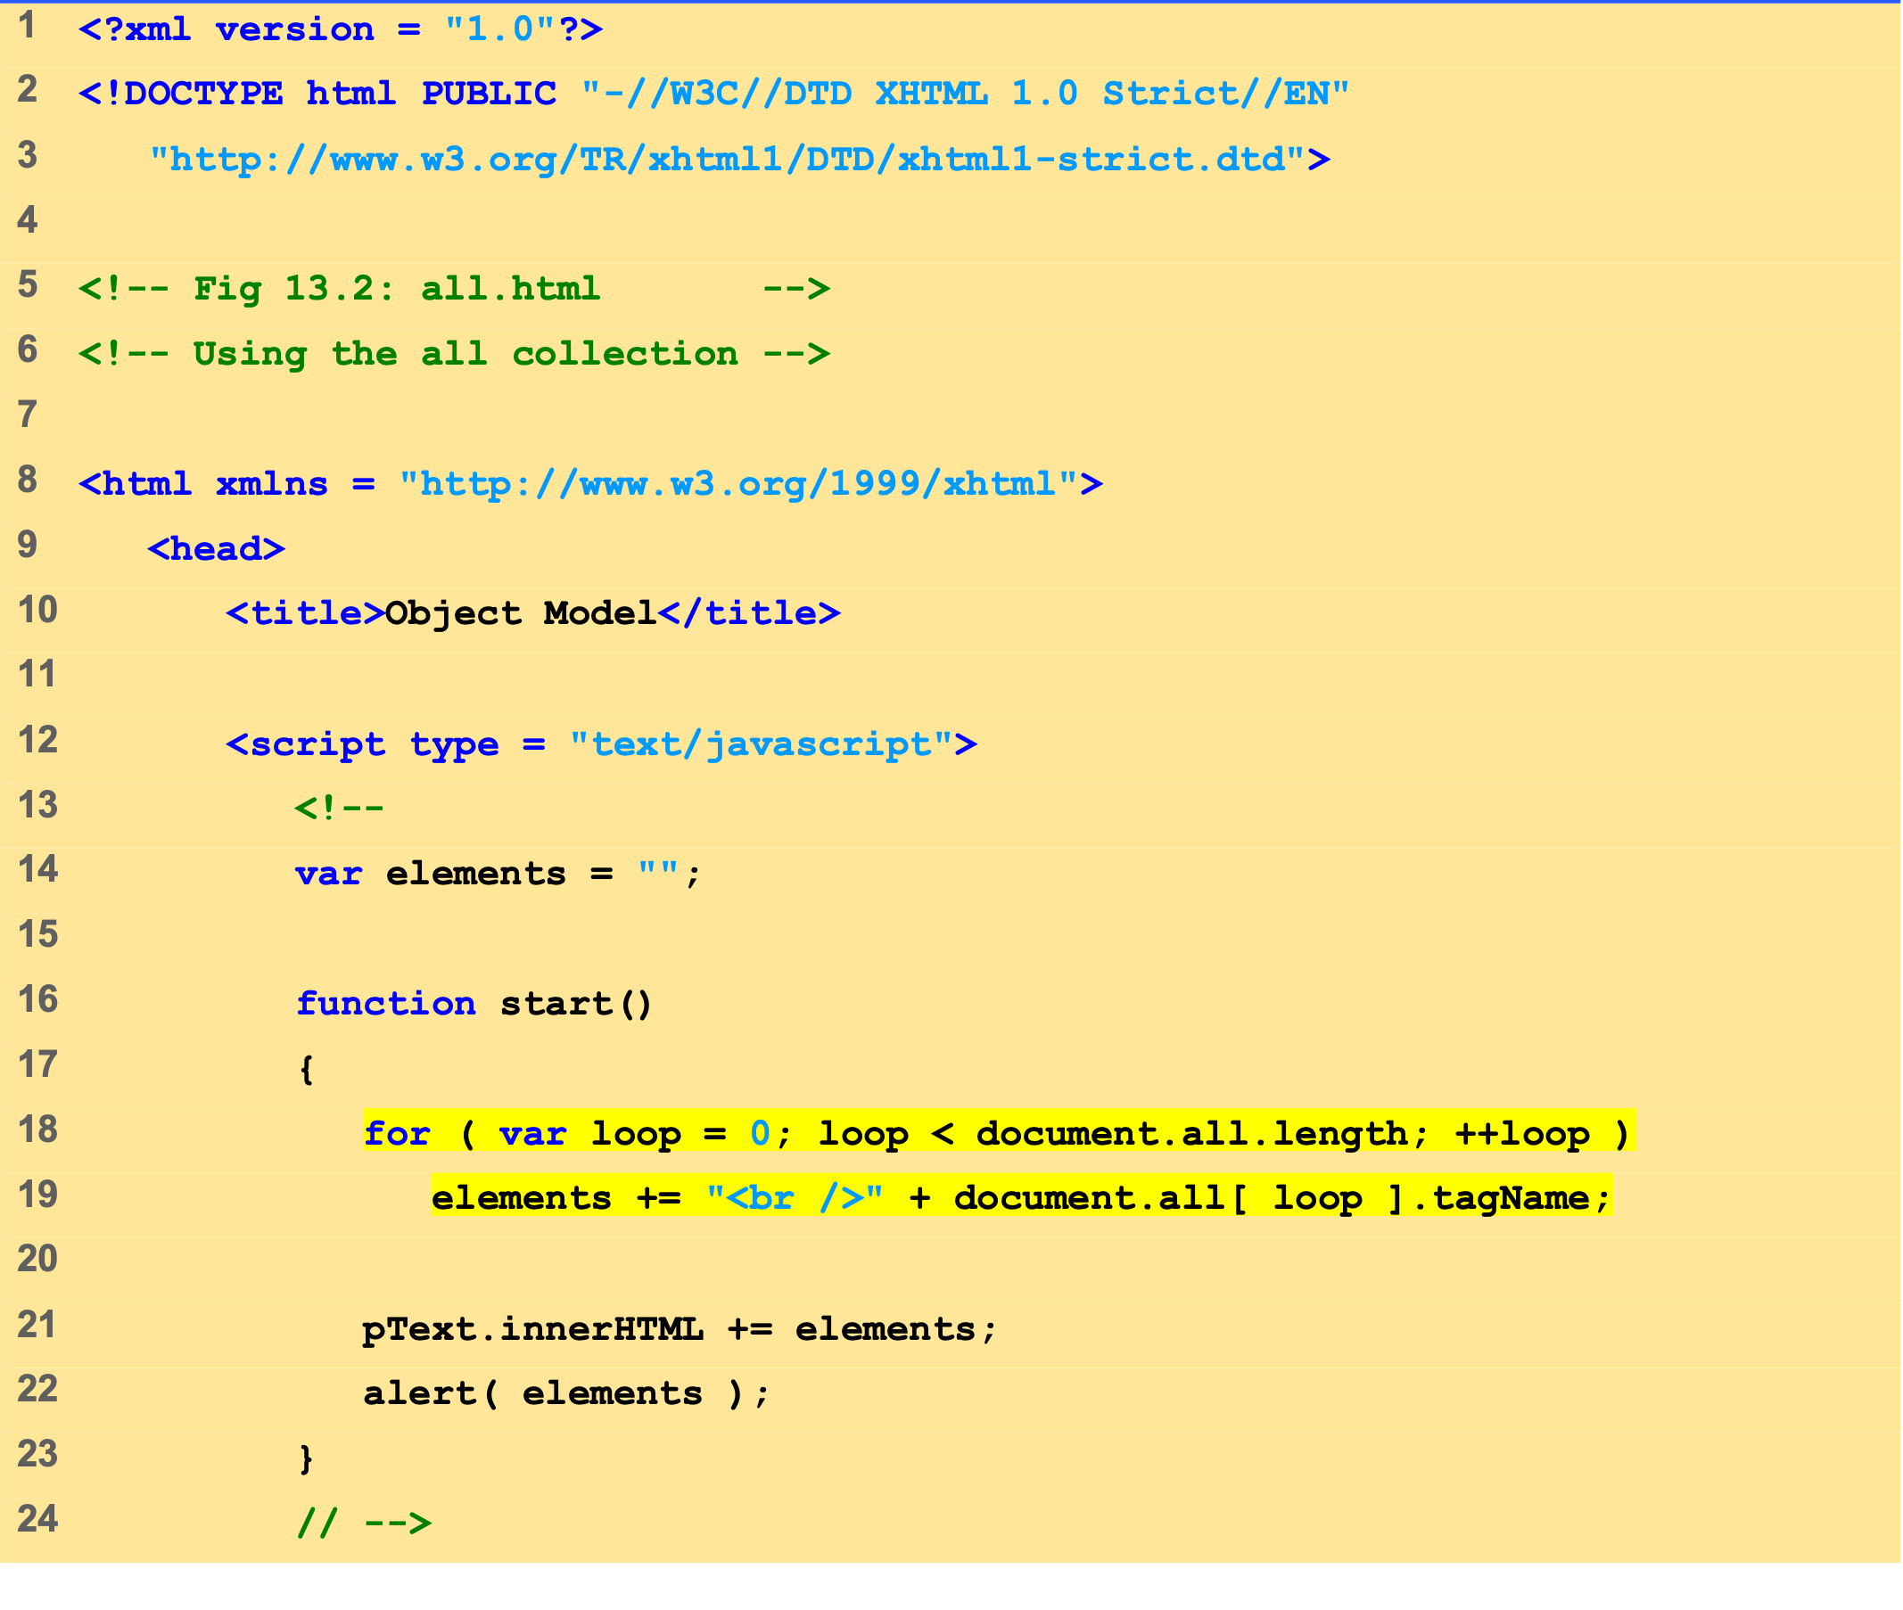
Outline
all.html (1 of 2)

Slide 9
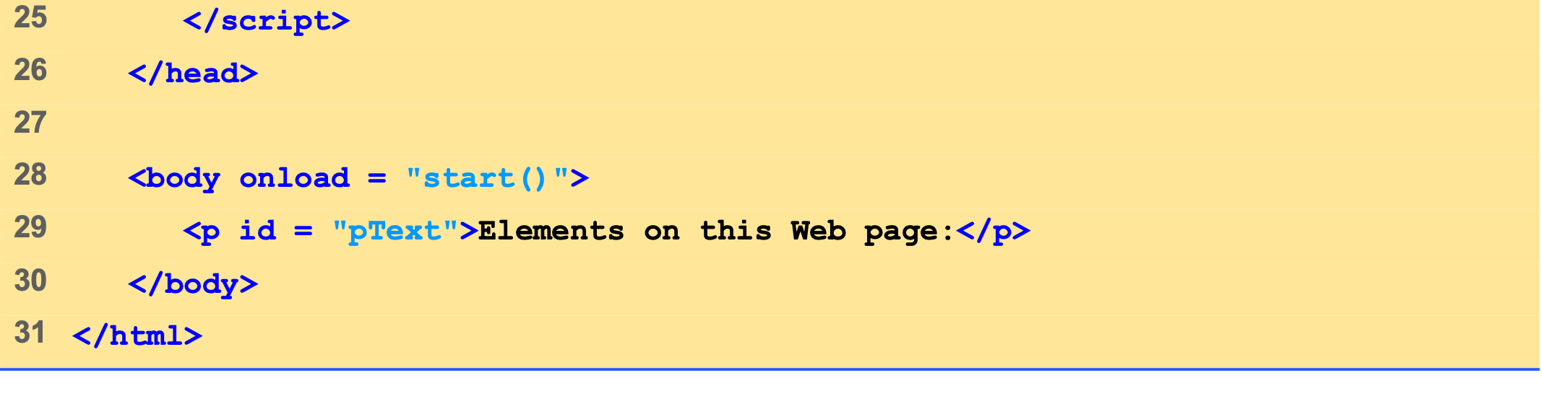
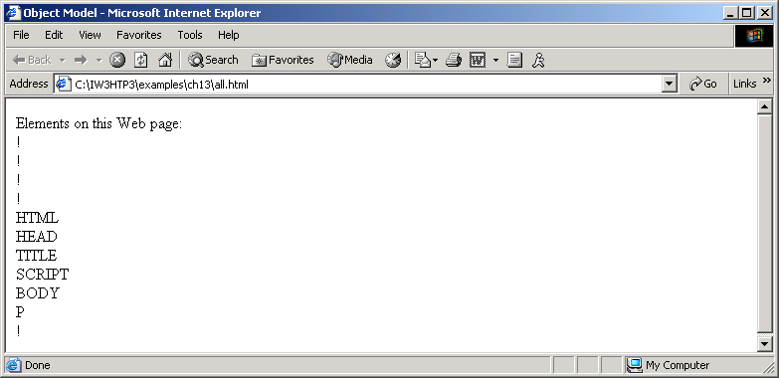
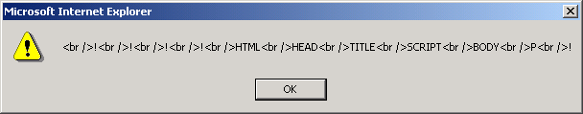
Outline
all.html (2 of 2)

Slide 10
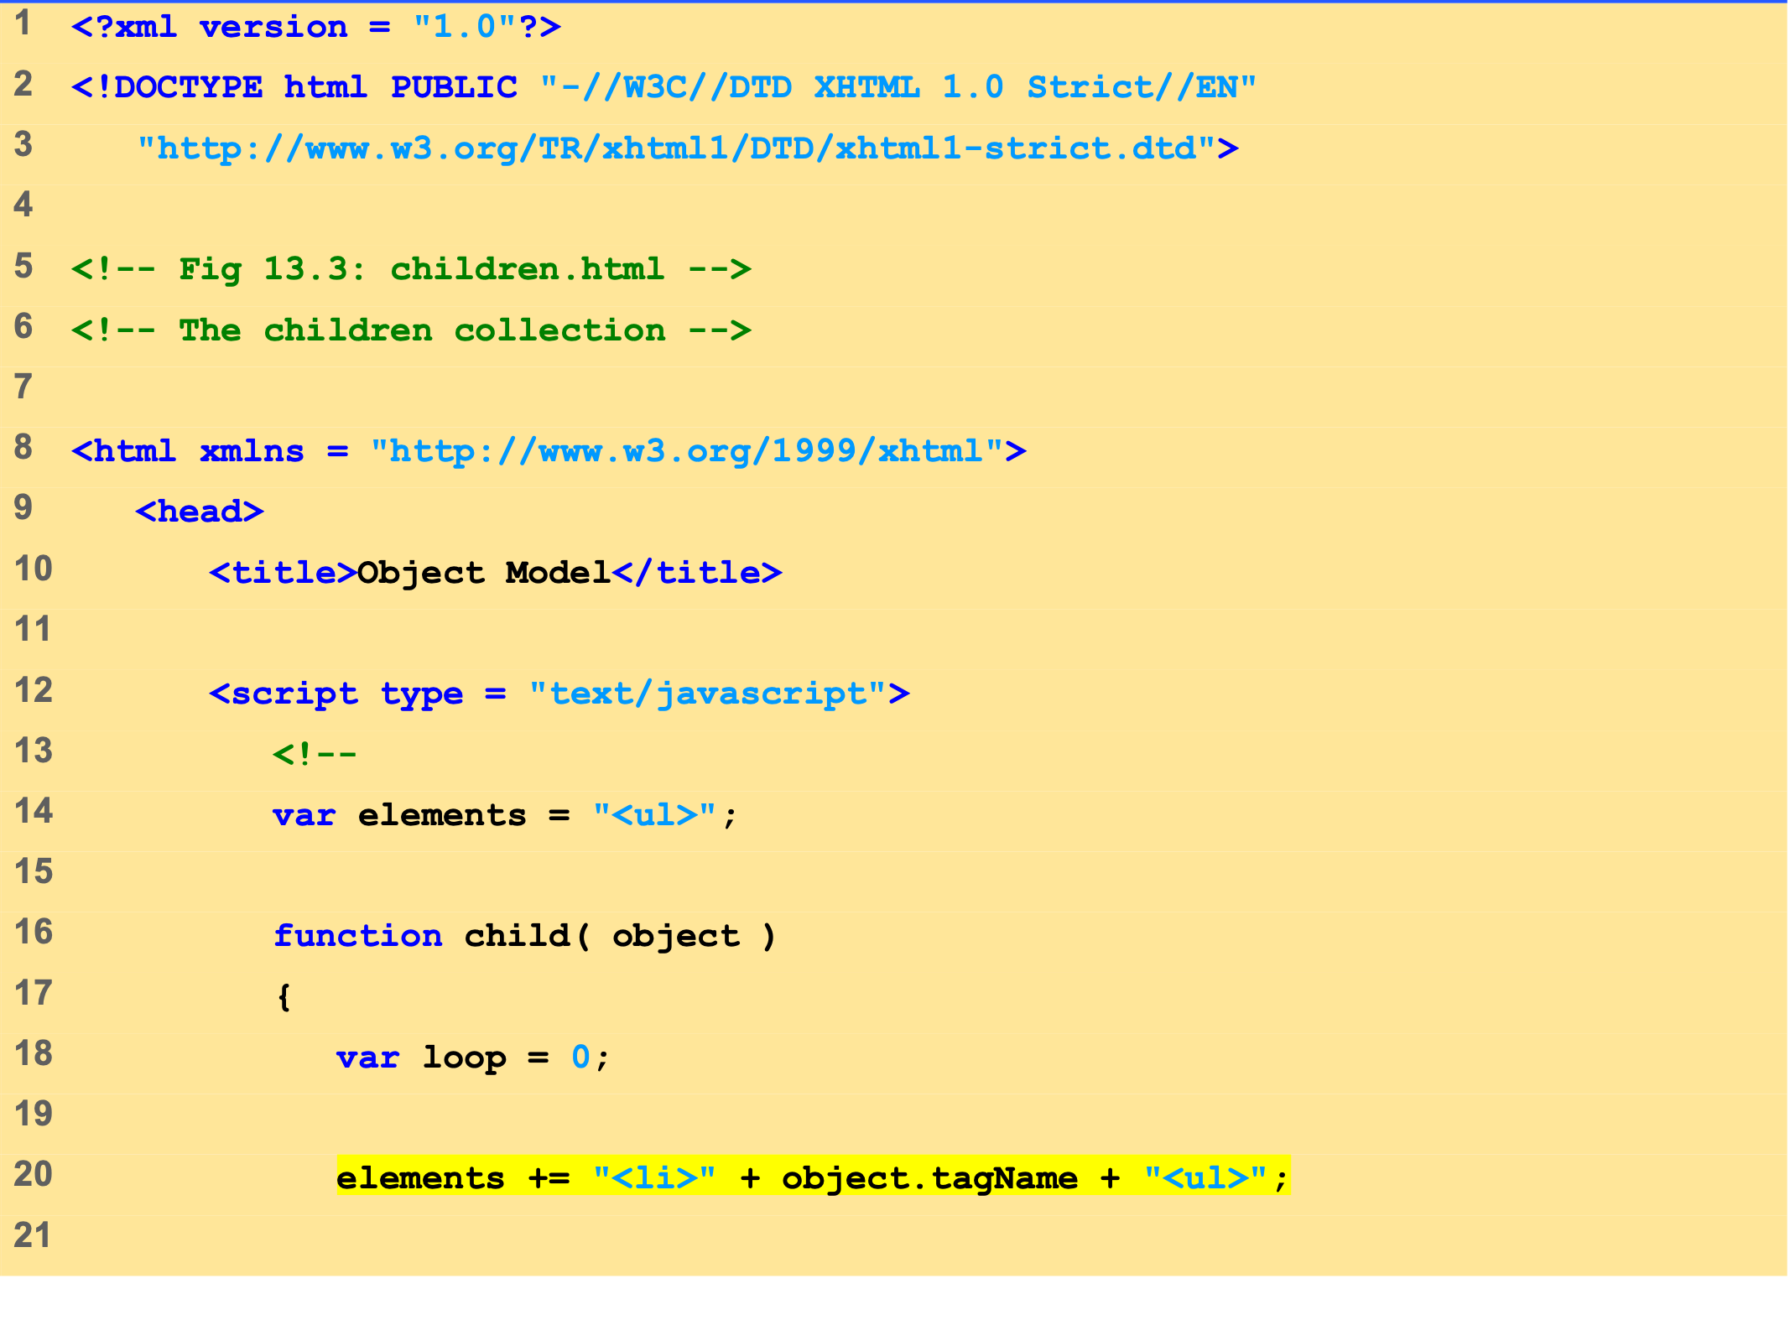
Outline
children.html (1 of 3)

Slide 11
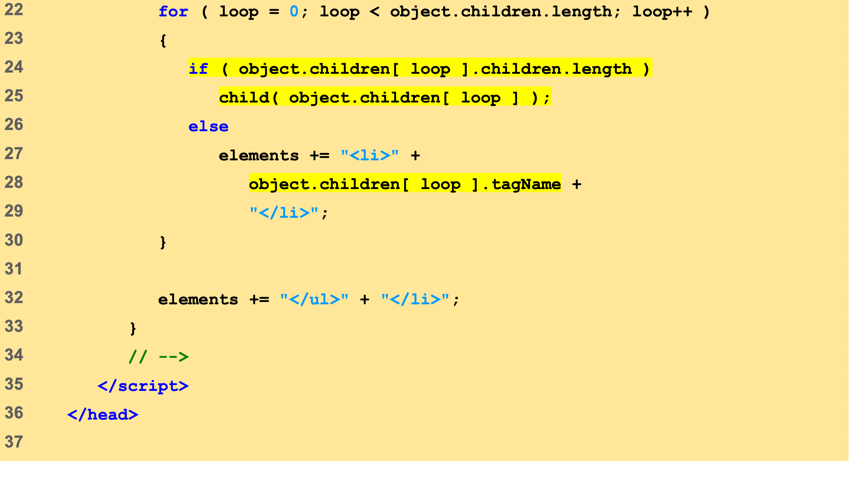
Outline
children.html (2 of 3)

Slide 12
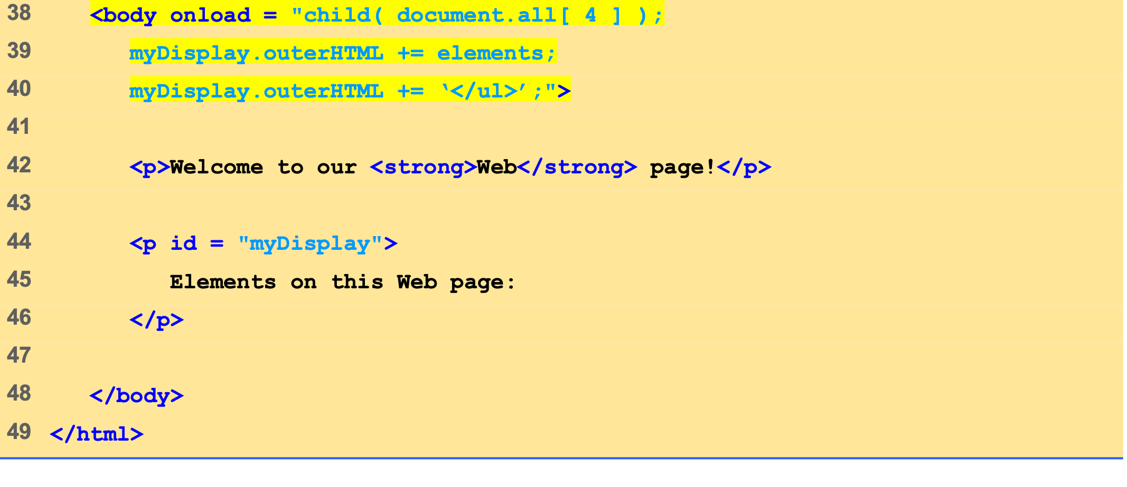
Outline
children.html (3 of 3)

Slide 13
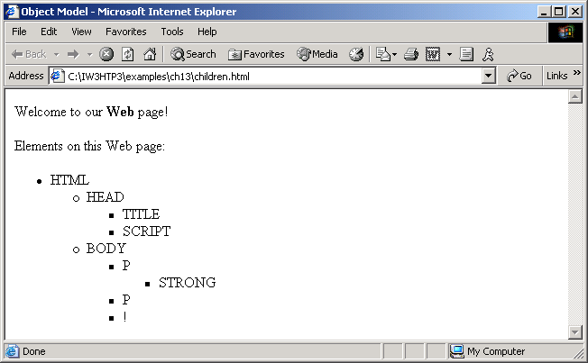

Slide 14
4 Dynamic Styles
Element’s style can be changed dynamically
Dynamic HTML Object Model also allows you to change the class attribute

Slide 15
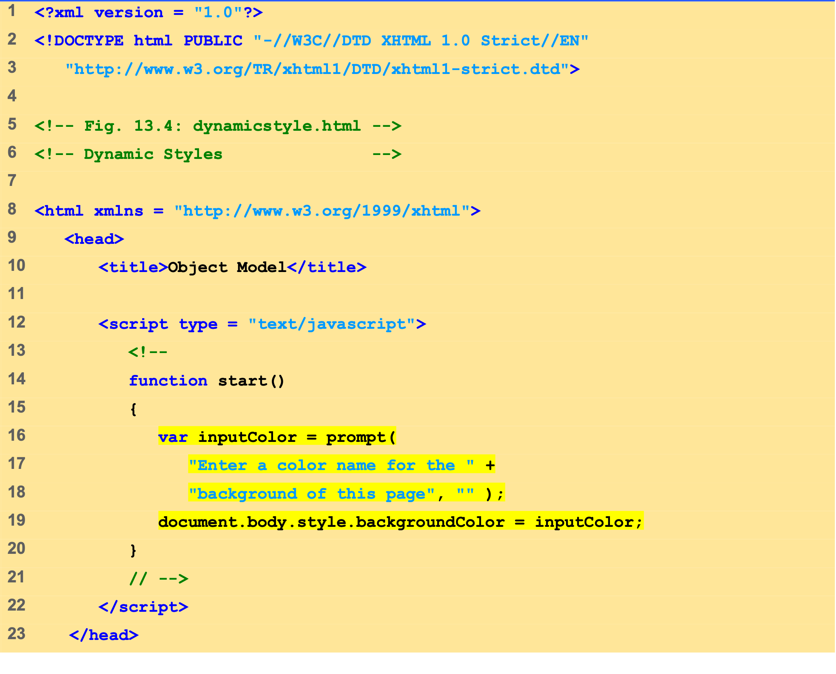
Outline
dynamicstyle.html (1 of 2)

Slide 16
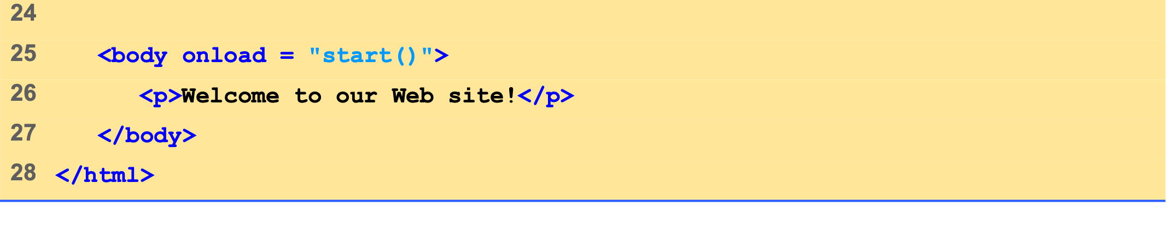
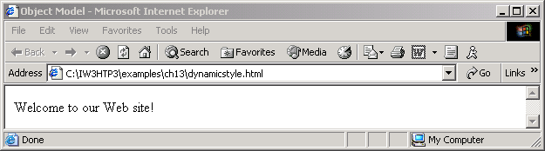
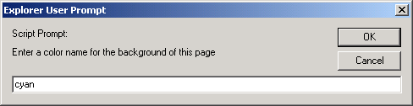
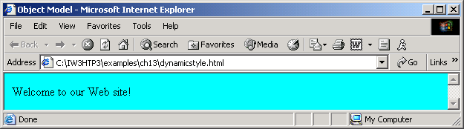
Outline
dynamicstyle.html (2 of 2)

Slide 17
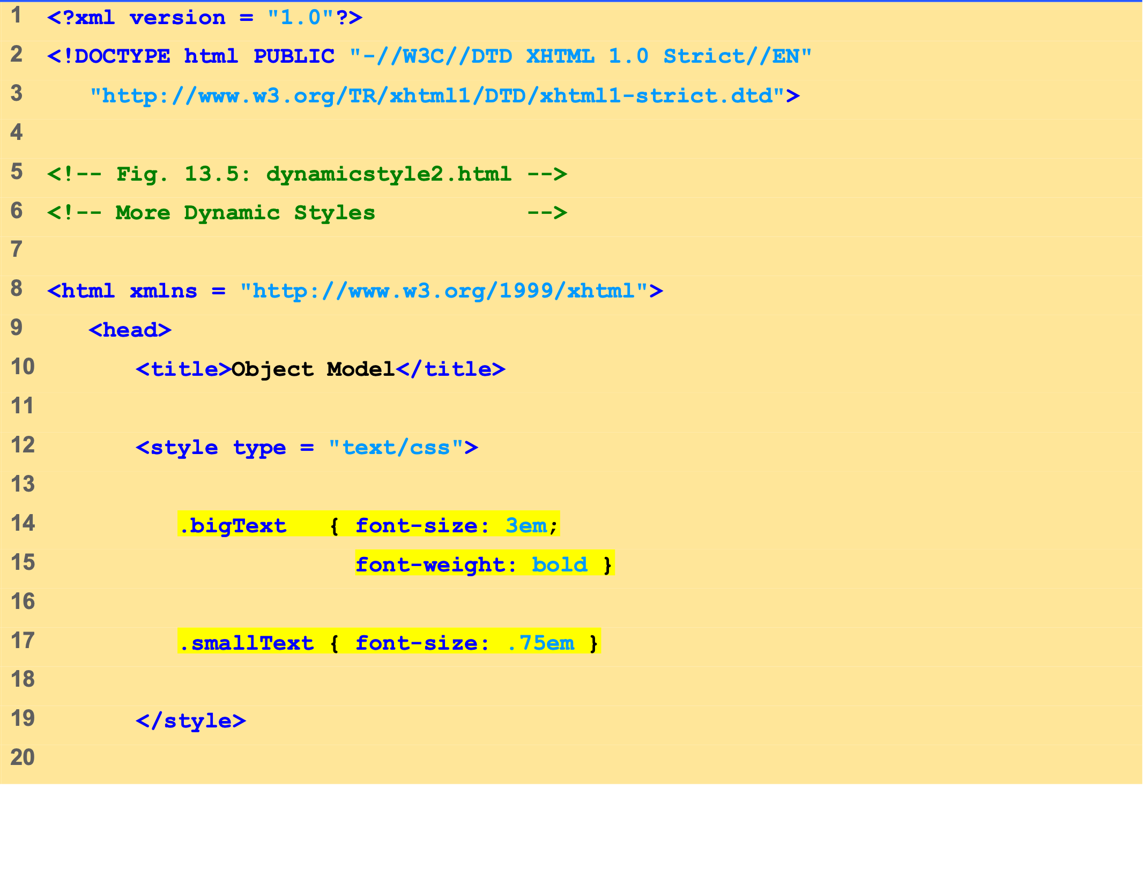
Outline
dynamicstyle2.html (1 of 2)

Slide 18
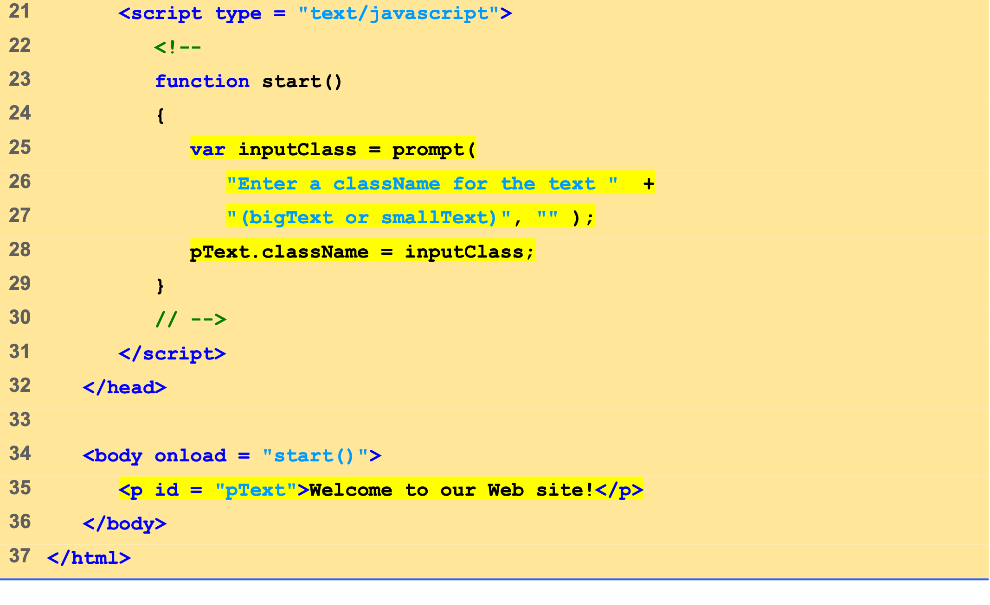
Outline
dynamicstyle2.html (2 of 2)

Slide 19
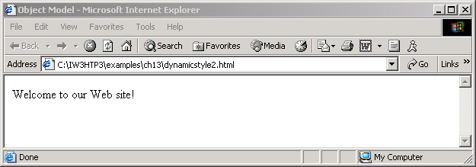
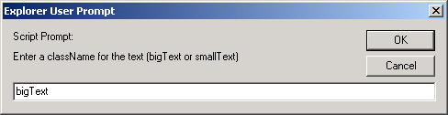
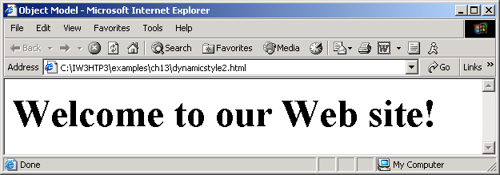

Slide 20
5 Dynamic Positioning
XHTML elements can be positioned with scripting
Declare an element’s CSS position property to be either absolute or relative
Move the element by manipulating any of the top, left, right or bottom CSS properties

Slide 21
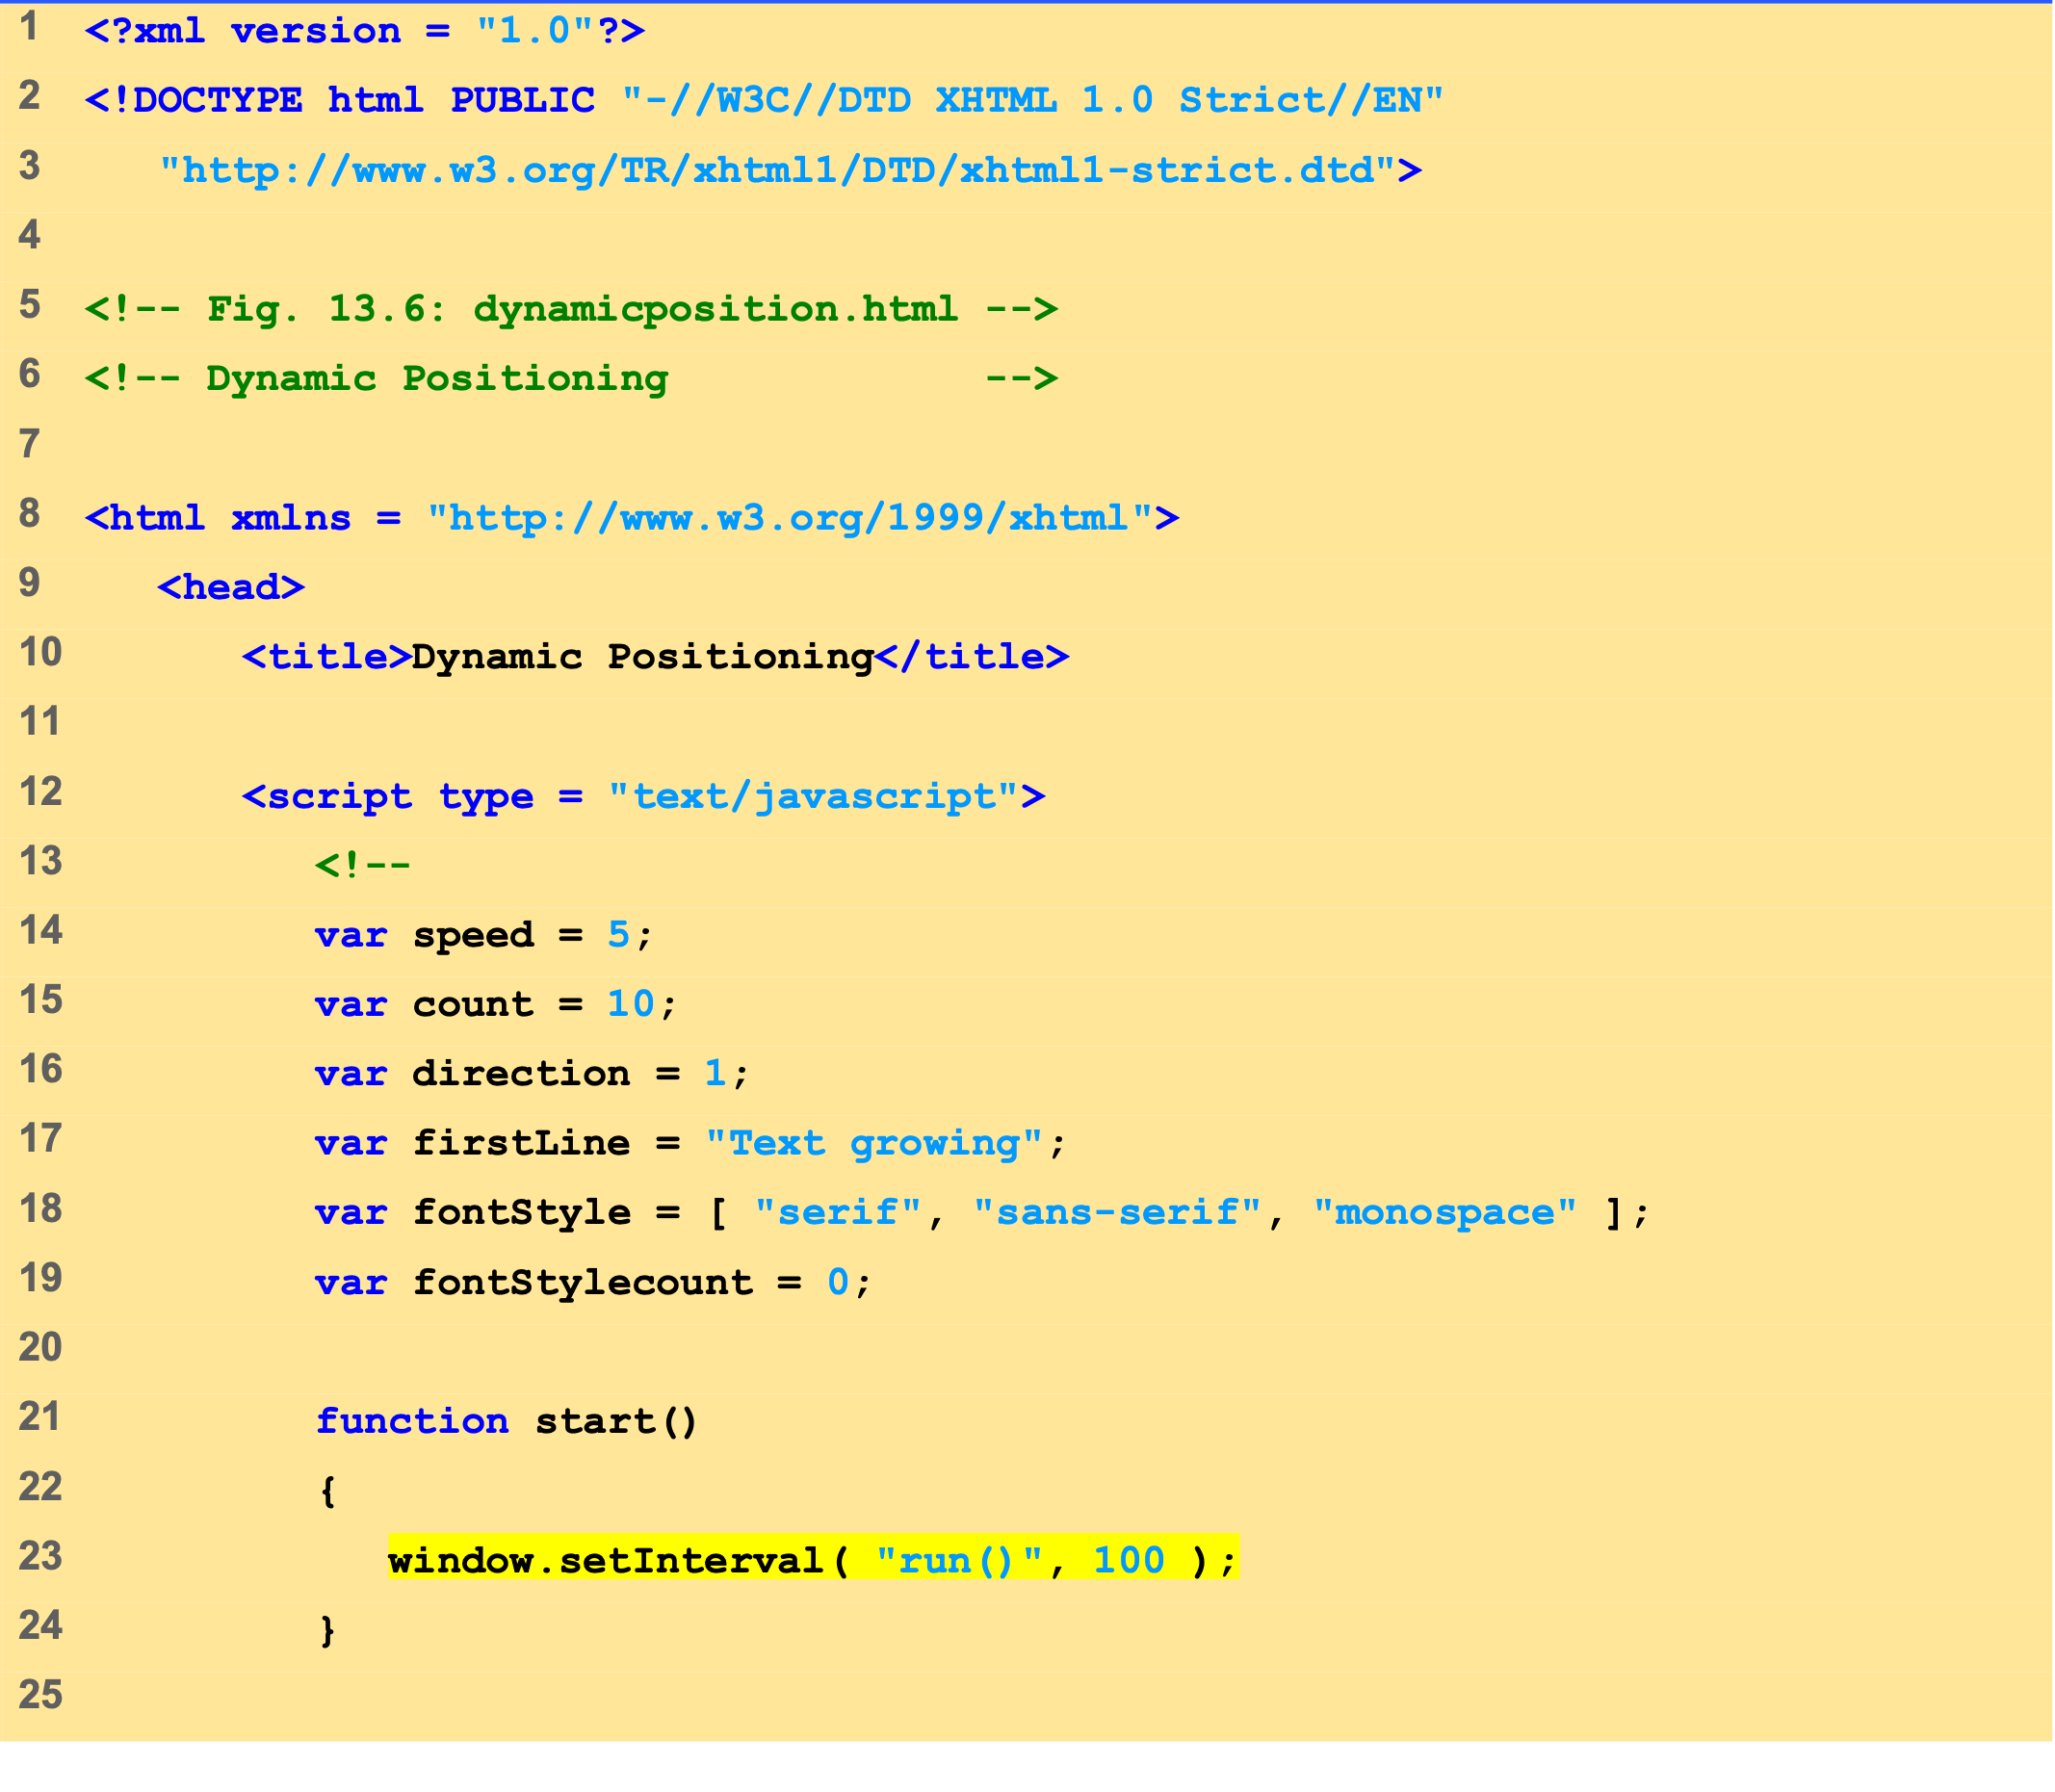
Outline
dynamicposition .html (1 of 3)

Slide 22
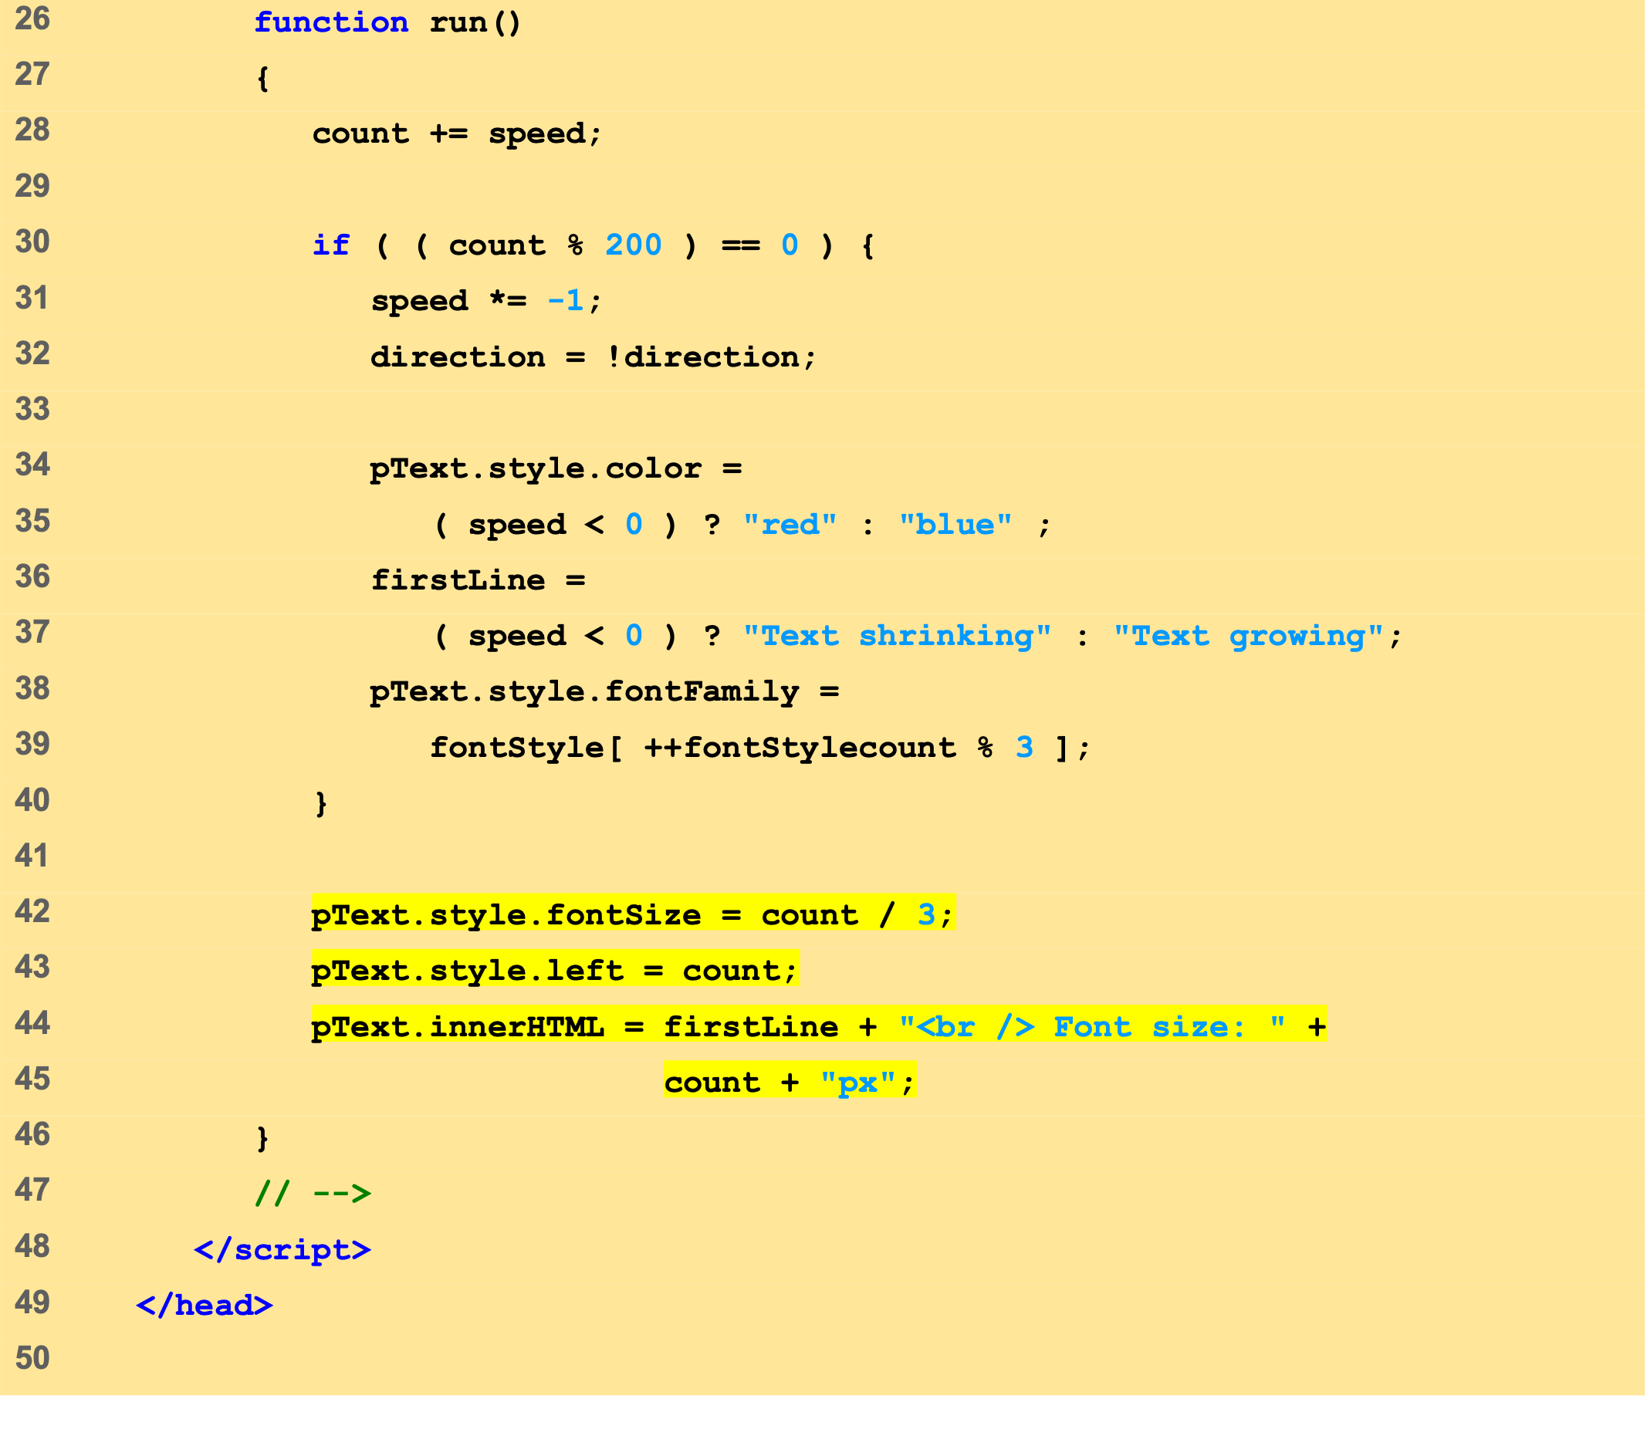
Outline
dynamicposition .html (2 of 3)

Slide 23
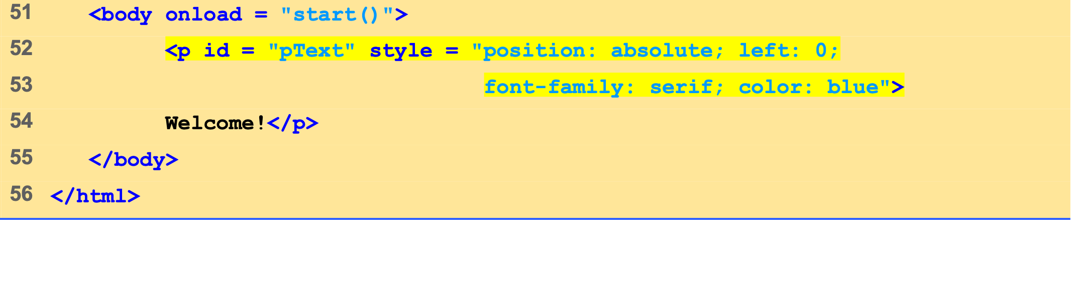
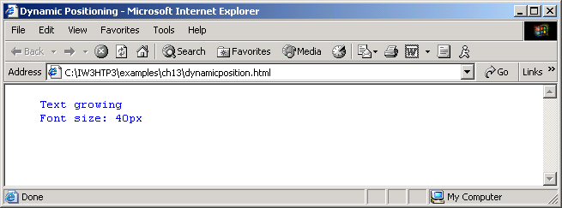
Outline
dynamicposition .html (3 of 3)

Slide 24
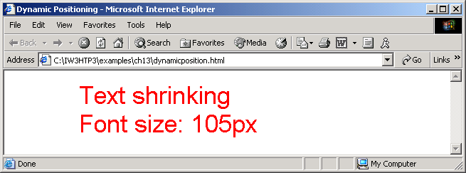
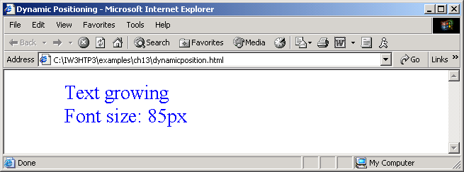

Slide 25
13.6 Using the frames Collection
Referencing elements and objects in different frames by using the frames collection

Slide 26
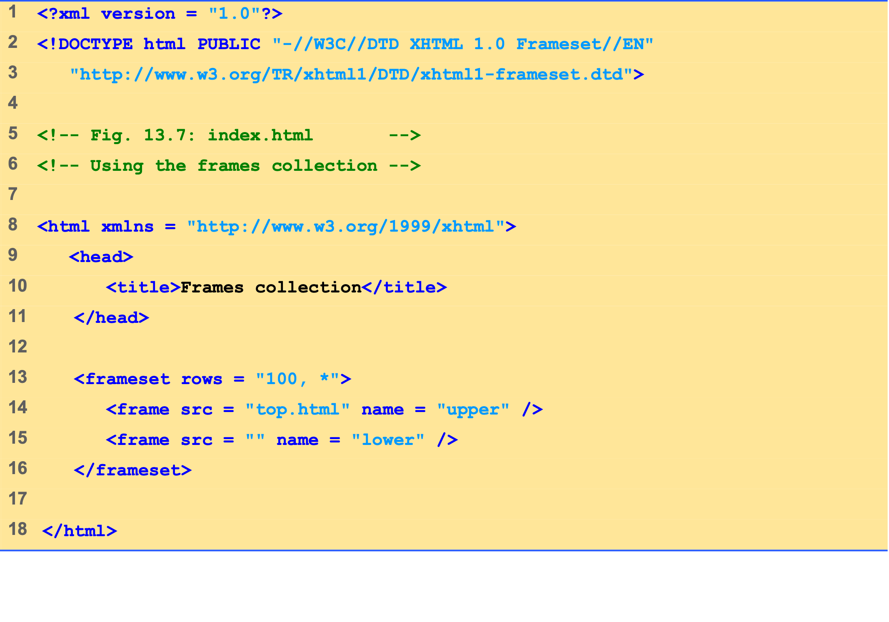
Outline
index.html (1 of 1)

Slide 27
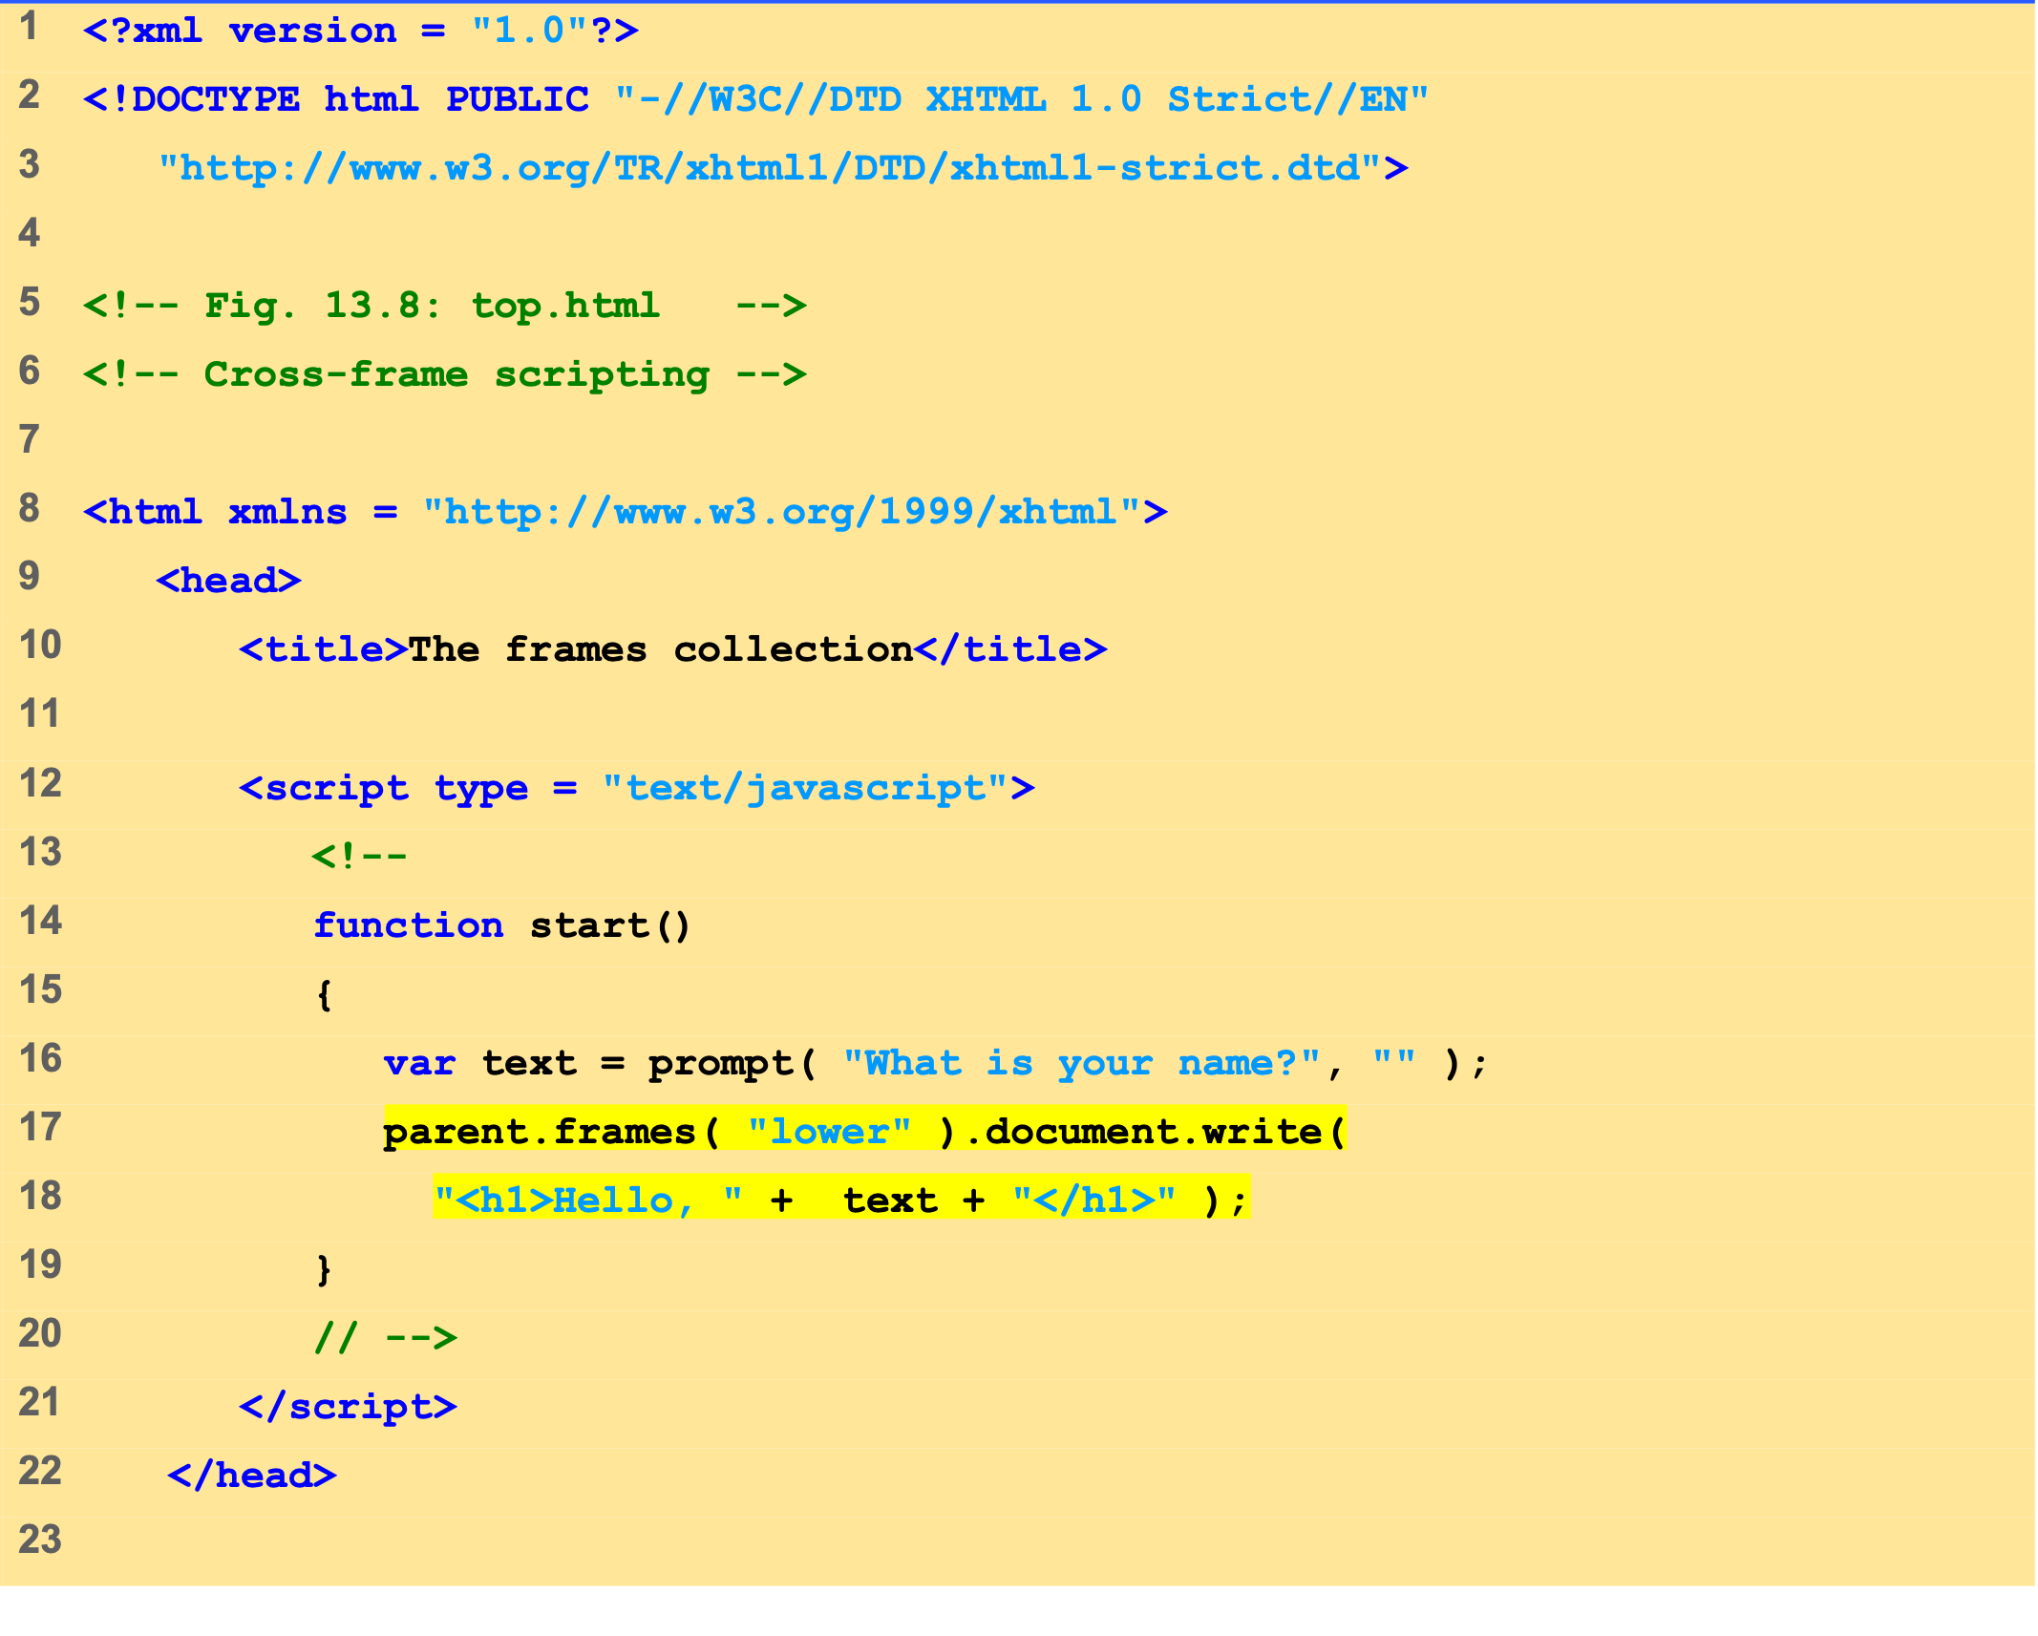
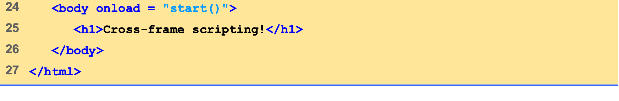
Outline
top.html (1 of 1)

Slide 28
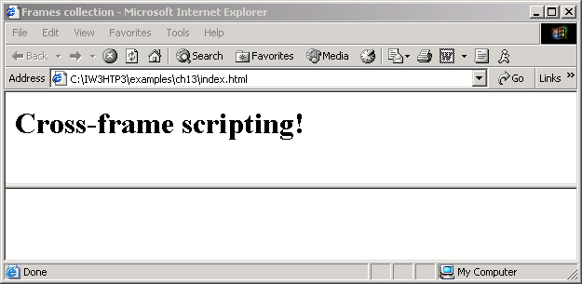
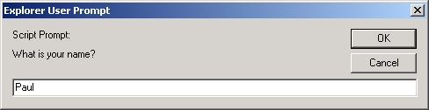
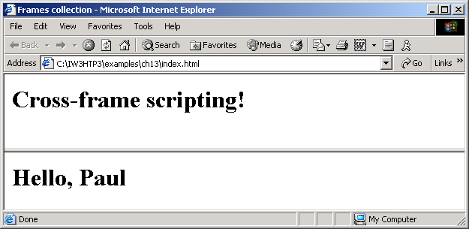

Slide 29
7 navigator Object
Netscape, Mozilla, Microsoft’s Internet Explorer
Others as well
Contains information about the Web browser
Allows Web authors to determine what browser the user is using

Slide 30
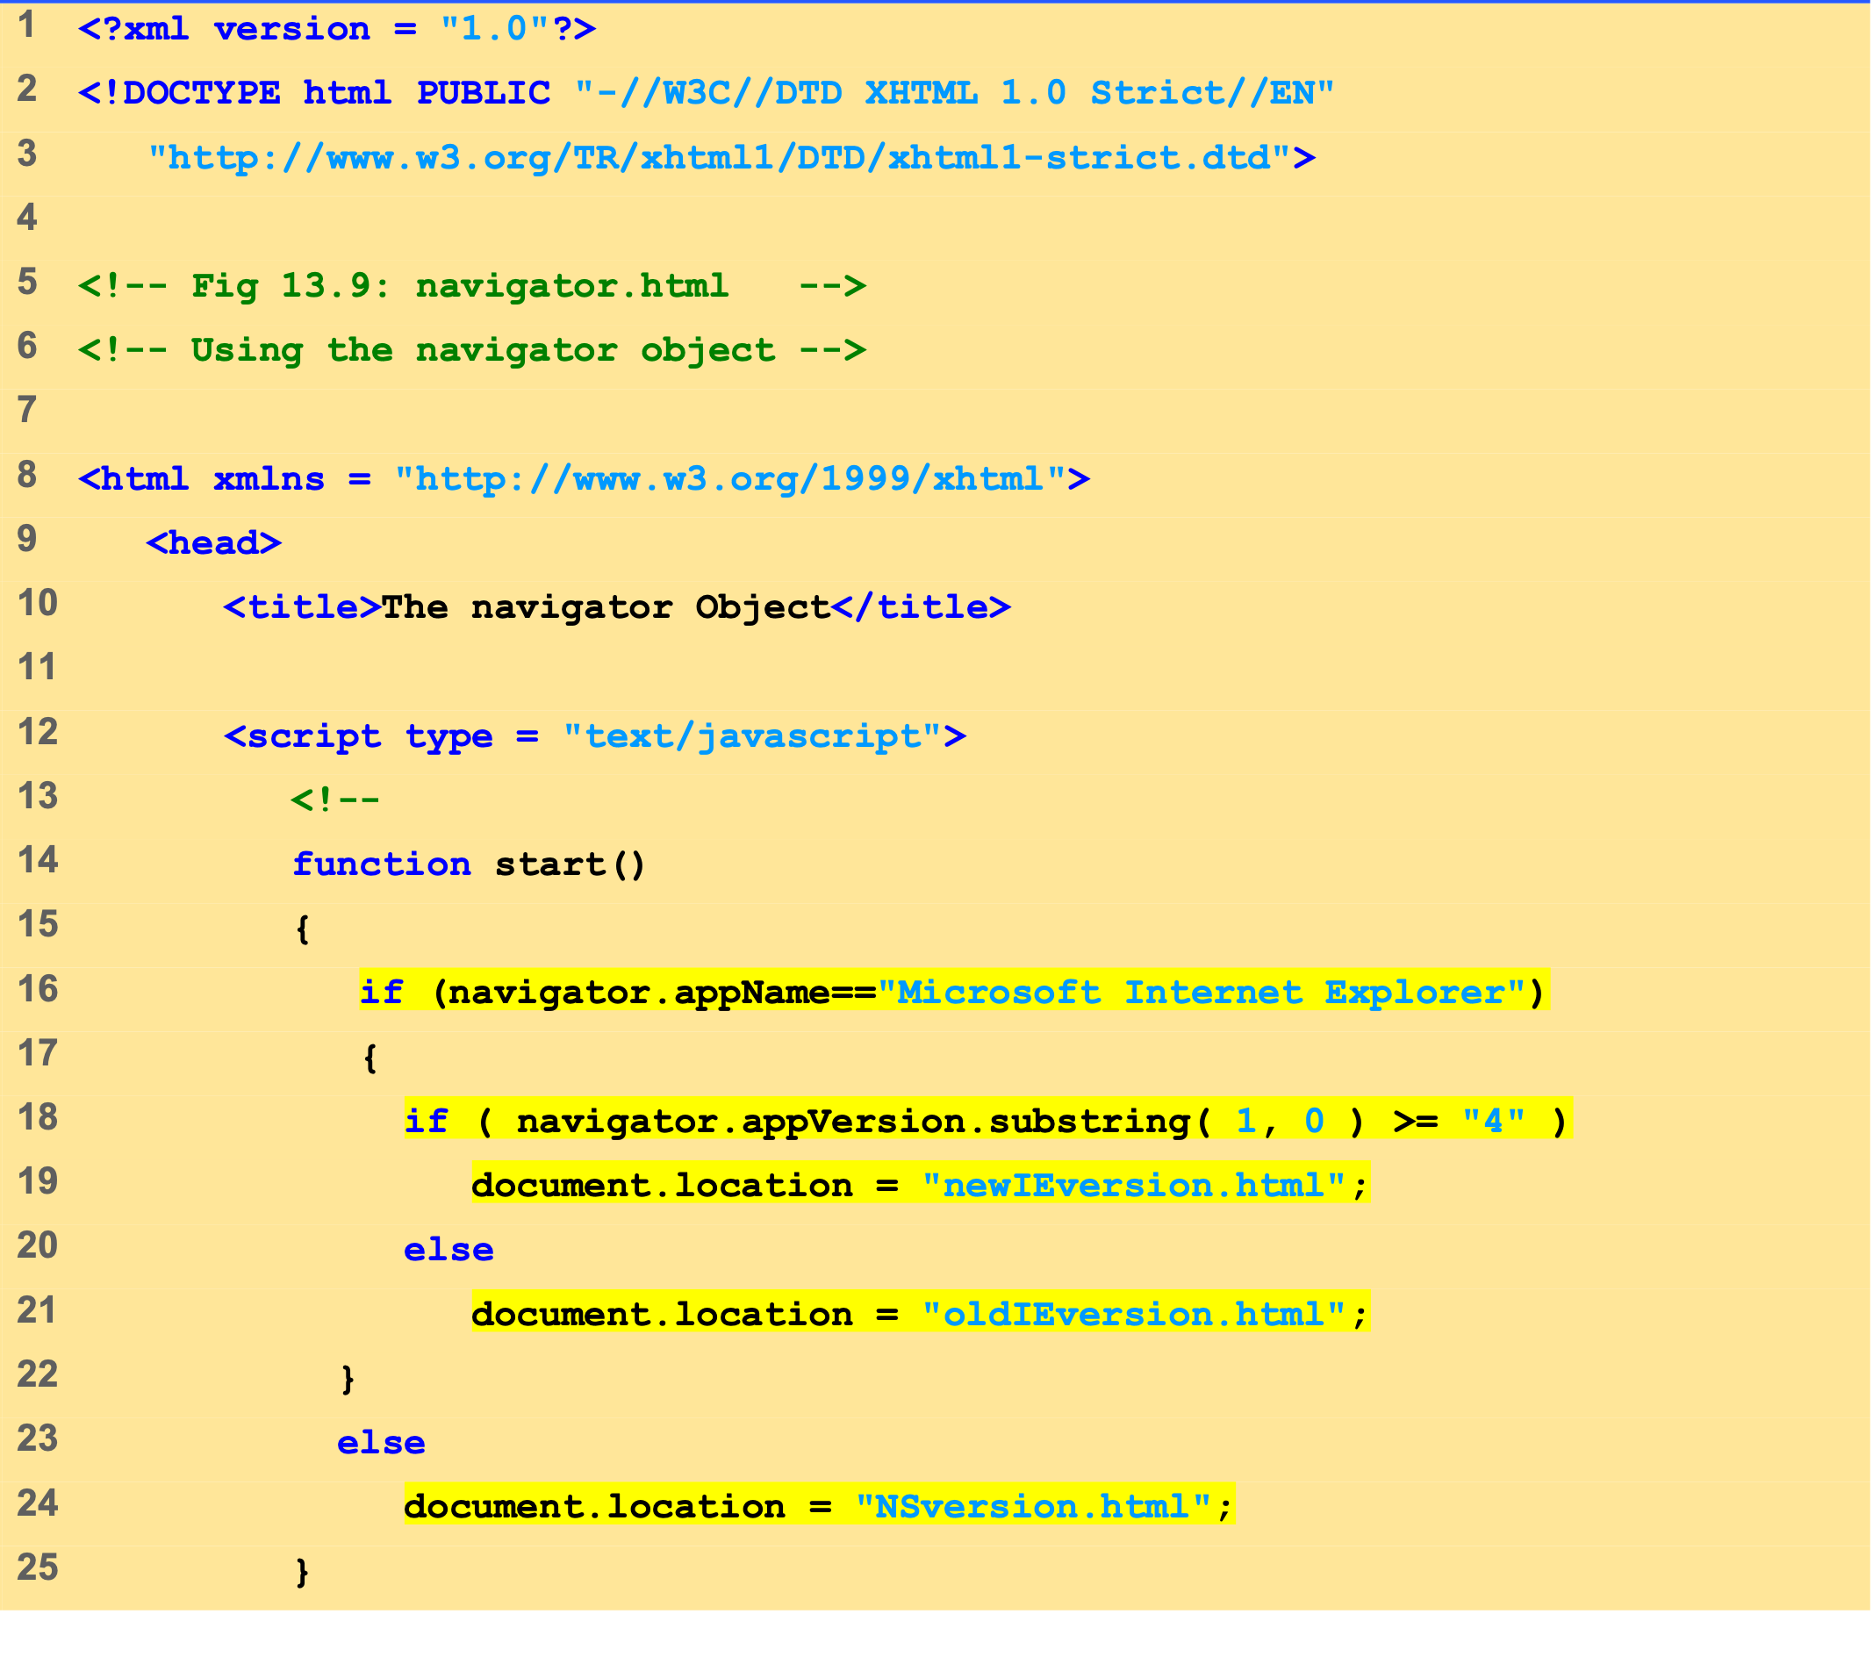
Outline
navigator.html (1 of 2)

Slide 31
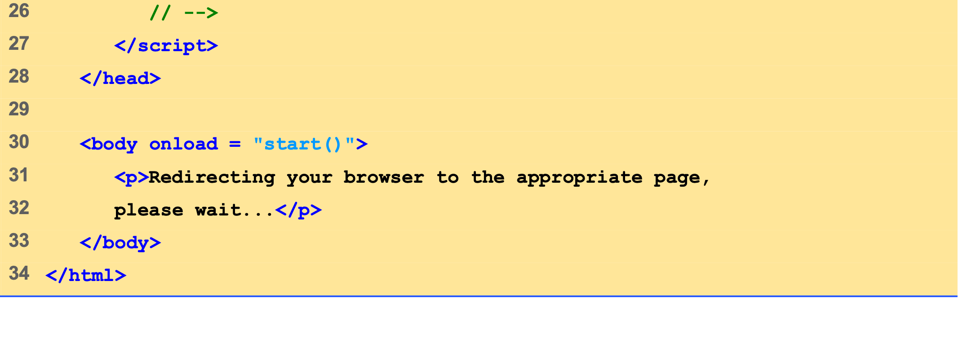
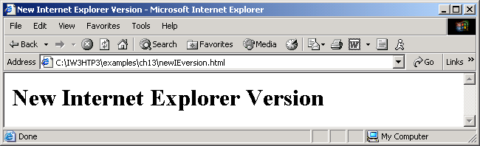
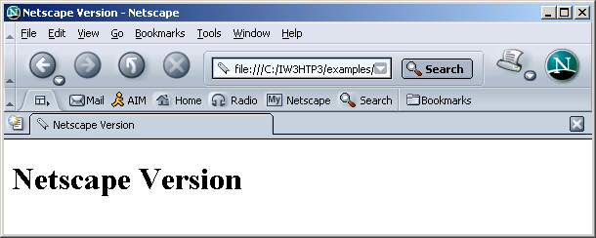
Outline
navigator.html (2 of 2)

Slide 32
8 Summary of the DHTML Object Model
window
document
all
frames
document
anchors
history
document
applets
navigator
body
plugins
location
embeds
event
filters
screen
forms
images
Key
links
object
plugins
collection
scripts
styleSheets
DHTML Object Model.

Slide 33
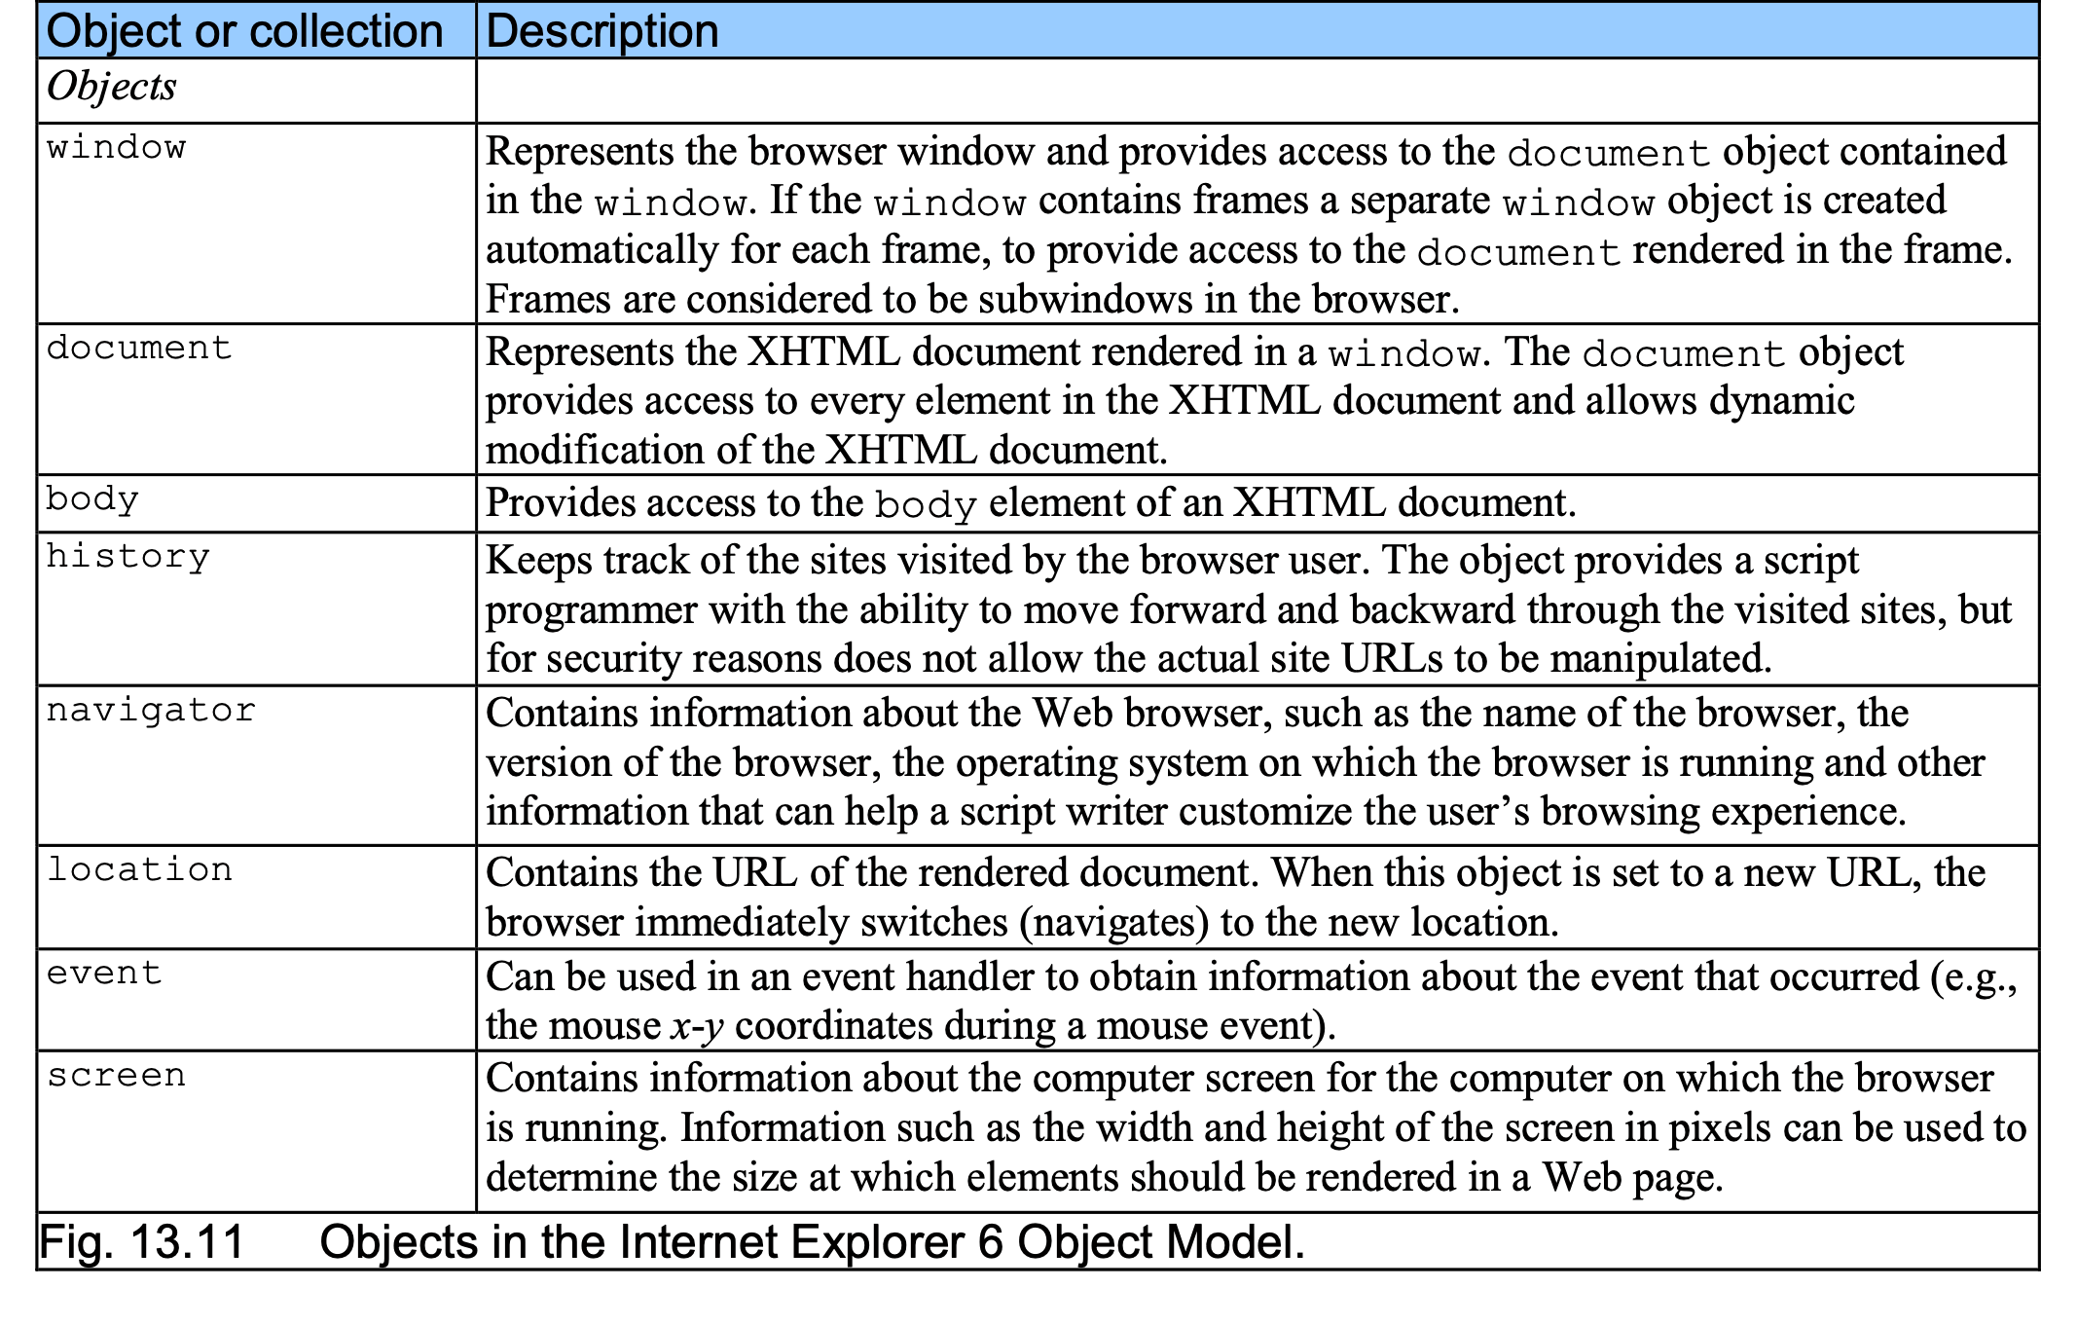
8 Summary of the DHTML Object Model

Slide 34
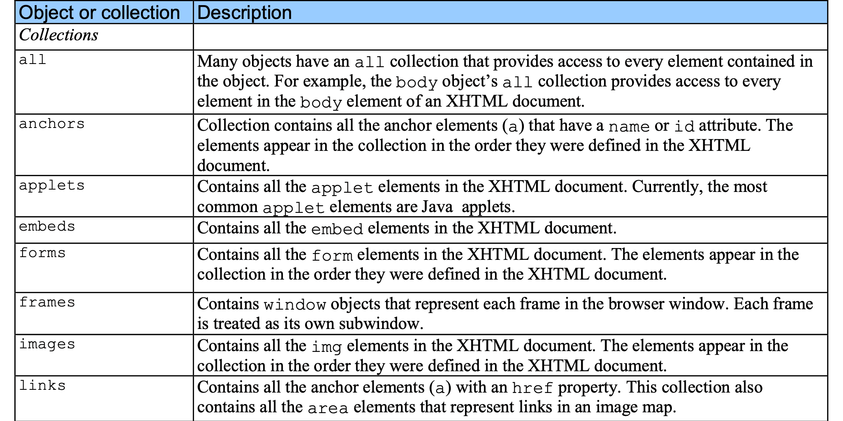
8 Summary of the DHTML Object Model

Slide 35
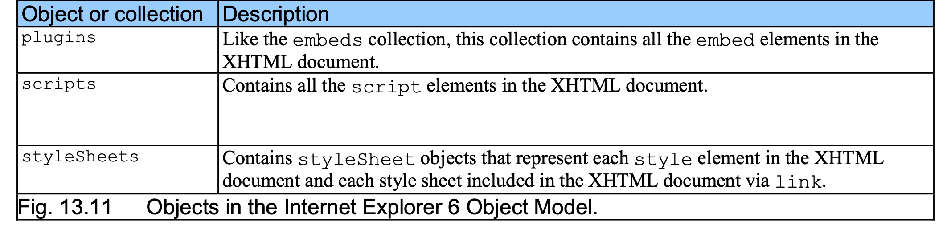
8 Summary of the DHTML Object Model

Slide 36
Web Resources
www.javascriptmall.com
developer.netscape.com/tech/javascript
www.mozilla.org/js/language
Deitel and deitel, Internet and World Wide Web How to Program: Third Edition

